Slide 1
LACP
Link Aggregation Control Protocol

Slide 2
What is Link Aggregation ?
Link aggregation allows you to combine multiple Ethernet links into a single logical link between two networked devices.
Link aggregation is sometimes called by other names:
Ethernet bonding, Link bundling, Port aggregation etc..
The most common device combinations involve connecting a switch to another switch, a server, a network attached storage (NAS) device, or a multi-port access point.
Network devices and management functions treat the link aggregation group (LAG) of multiple Ethernet connections as a single link. For example, we can include a LAG in a virtual local area network (VLAN).
We can also configure more than one LAG on the same switch, or add more than two Ethernet links to the same LAG (the maximum number of links per LAG depends on your device).
Some network devices support Link Aggregation Control Protocol (LACP), which helps to prevent errors in the link aggregation setup process.

Slide 3
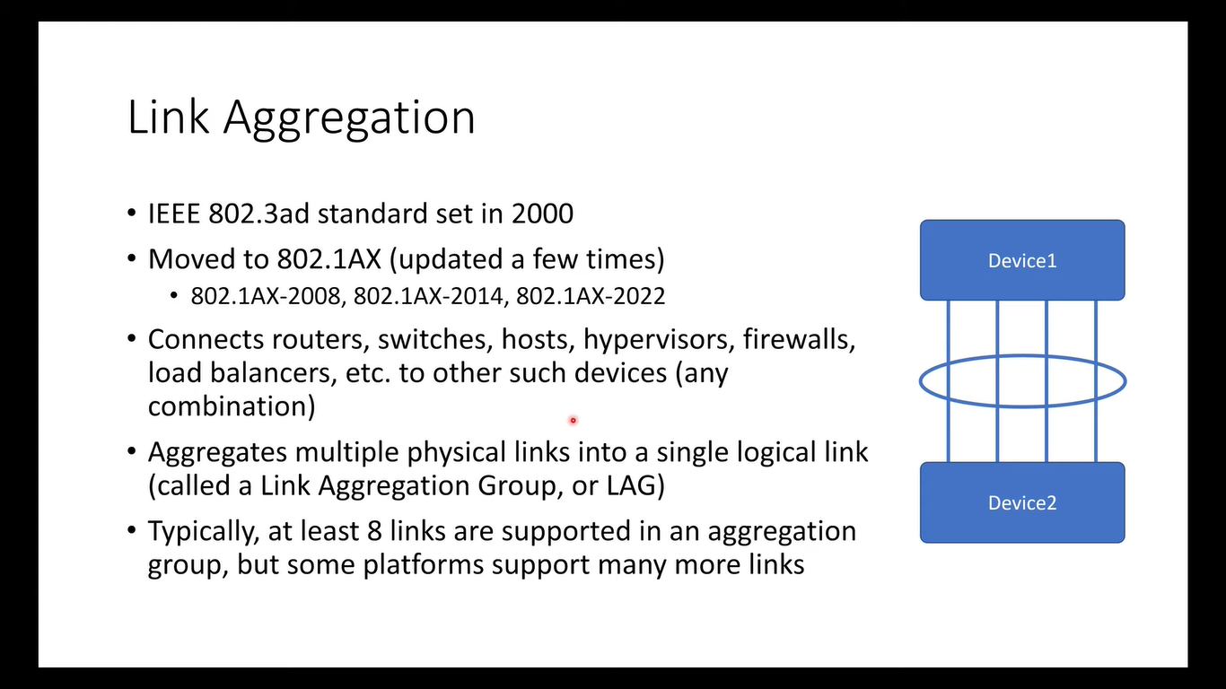

Slide 4
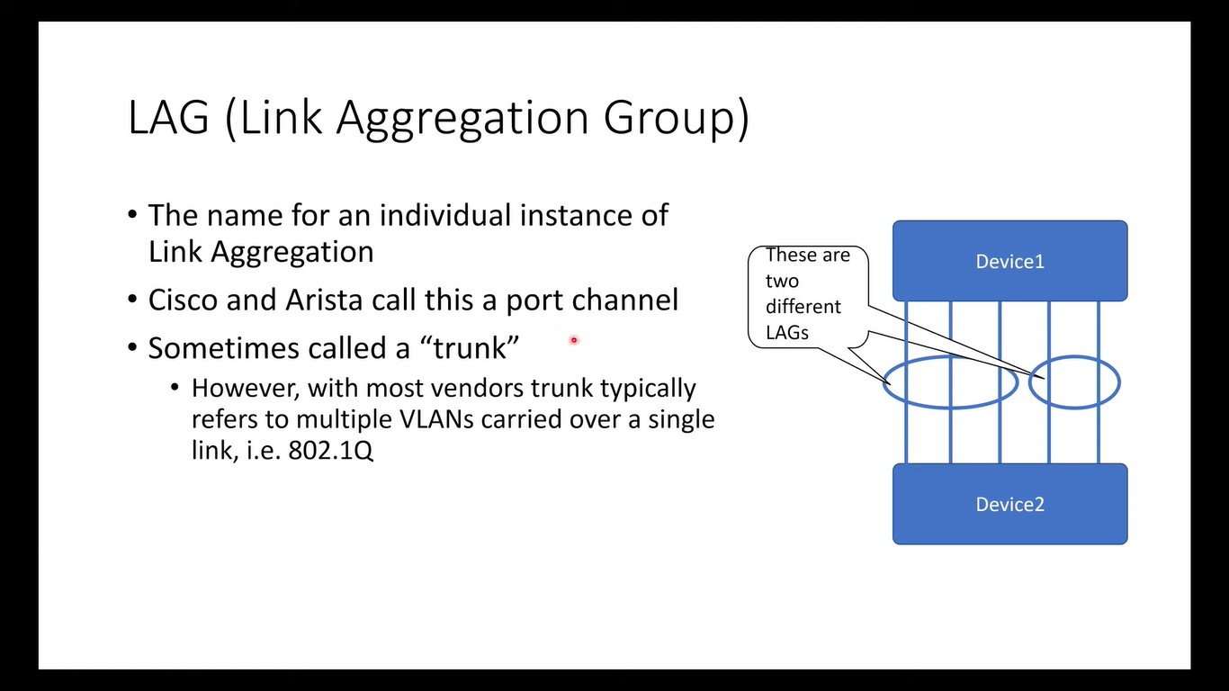

Slide 5
Types of LAGs
The Two primary types of LAGs are static and dynamic.
Static is also known as manually configured LAG
Dynamic LAGs use Link Aggregation Control Protocol (LACP) to negotiate settings between the two connected devices.
Some devices support static LAGs, but do not support dynamic LAGs with LACP.
Refer to your product’s user manual to see whether your device supports LACP.

Slide 6
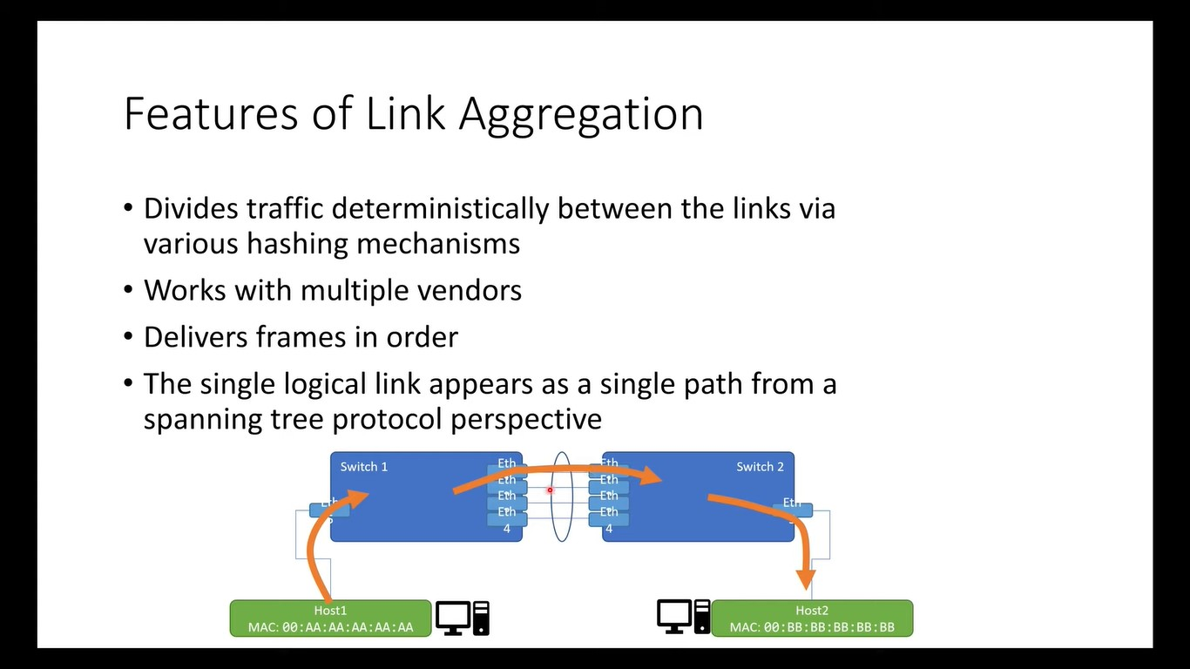

Slide 7
What are the benefits of Link Aggregation?
Increased reliability and availability: If one of the physical links in the LAG goes down, traffic is dynamically and transparently reassigned to one of the other physical links.
Better use of physical resources: Traffic can be load-balanced across the physical links.
Increased bandwidth: The aggregated physical links deliver higher bandwidth than each individual link.
Cost effectiveness: A physical network upgrade can be expensive, especially if it requires new cables. Link aggregation increases bandwidth without requiring new equipment.
Loop Free Network : By considering all the physical links as single logical link, avoids Spanning Tree port blocking issues.

Slide 8
MAC Flapping
A MAC Flap is caused when a switch receives packets from two different interfaces with the same source MAC address.
This Will cause lot of flapping; means we are not sure that which interface will be used. What ever the interface will by suggested by the forwarding table at that movement will be considered.

Slide 9
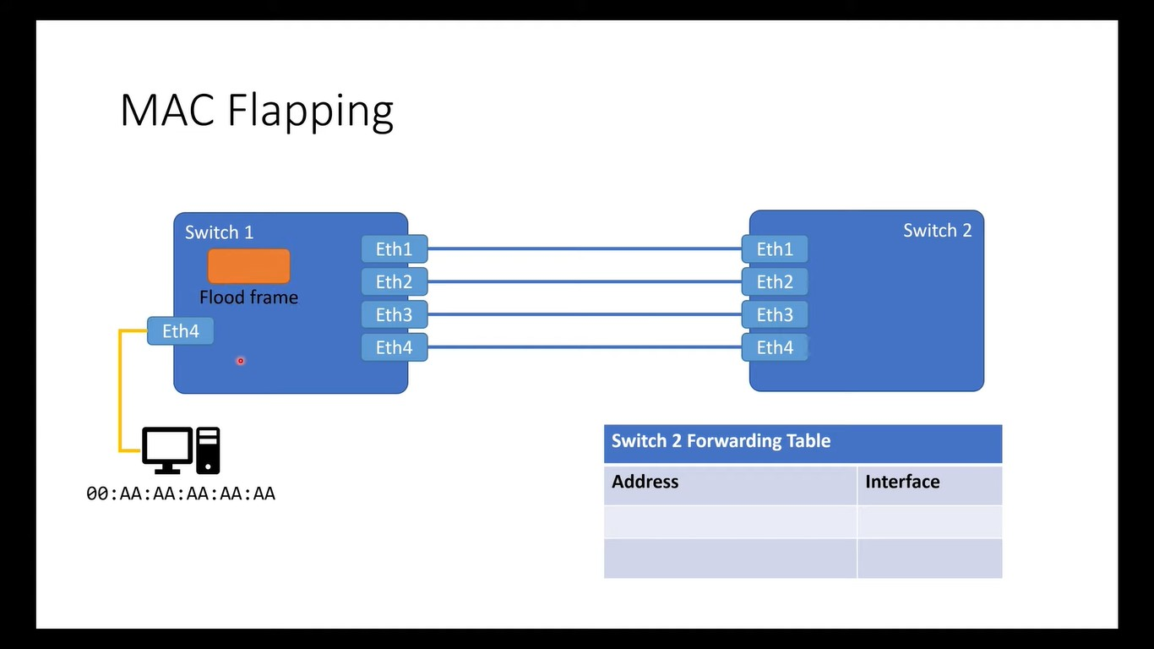

Slide 10
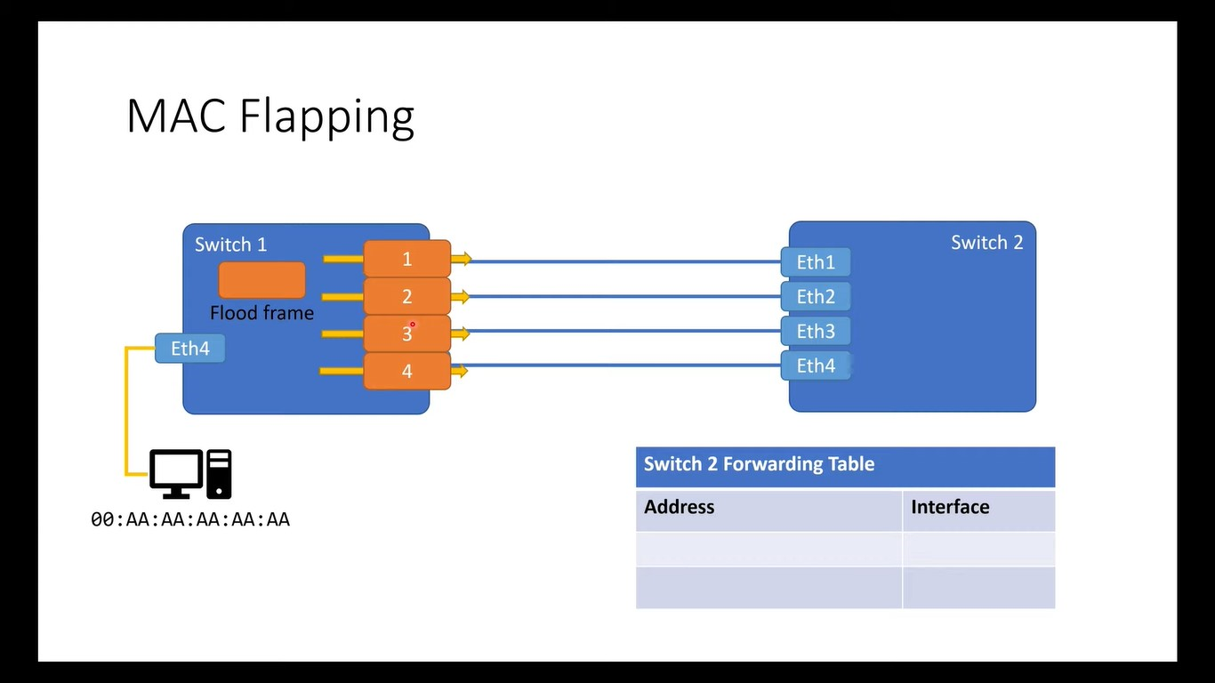

Slide 11
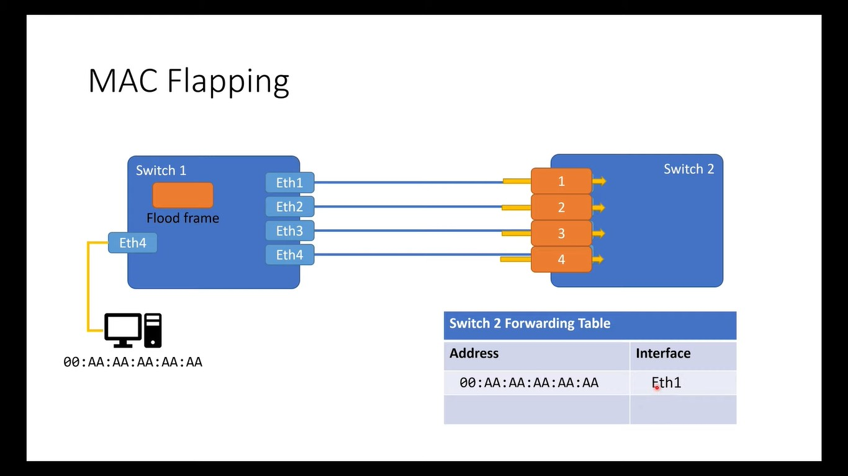

Slide 12


Slide 13


Slide 14


Slide 15
Broadcast Storm
A Broadcast Storm is basically a situation when an abruptly large number of broadcast packets in a very small amount of time.
Due to the broadcast storm, the network quality degrades significantly.
It leads to broadcast and multicast traffic accumulation on a computer network.

Slide 16
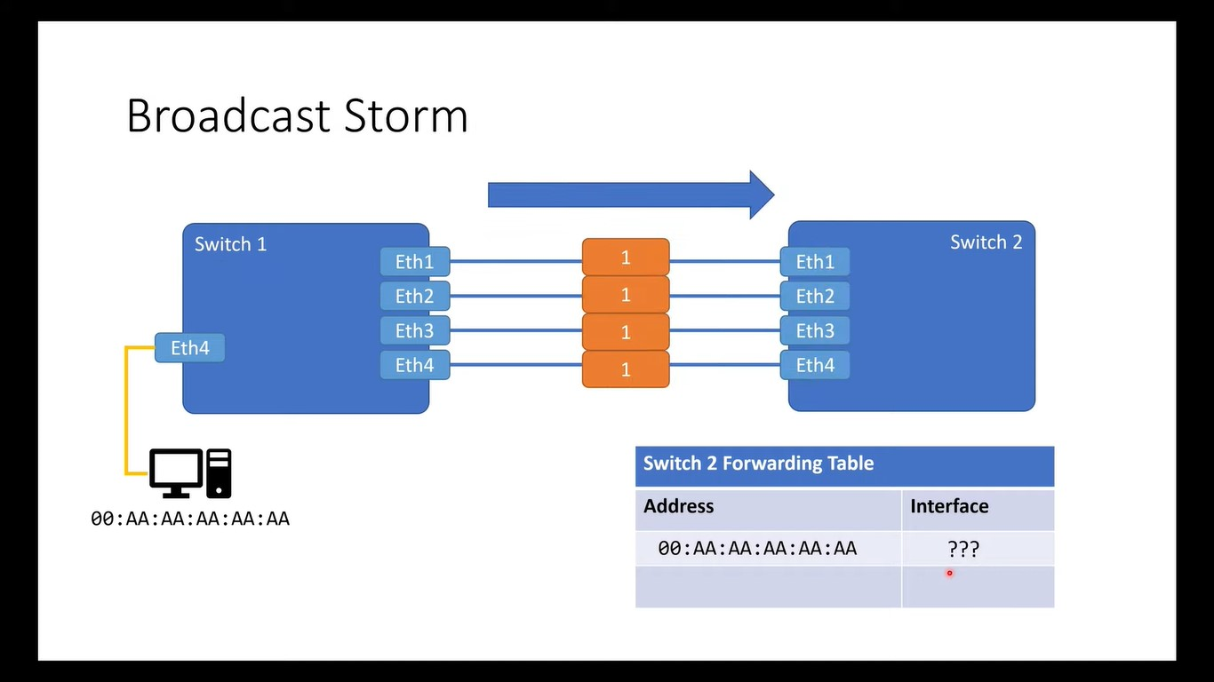

Slide 17
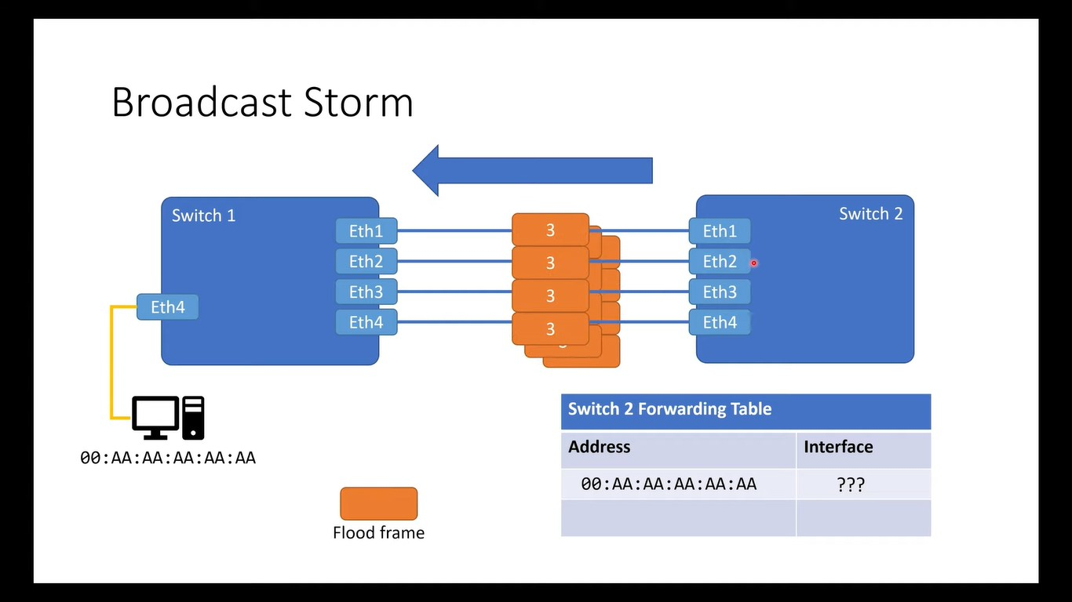

Slide 18
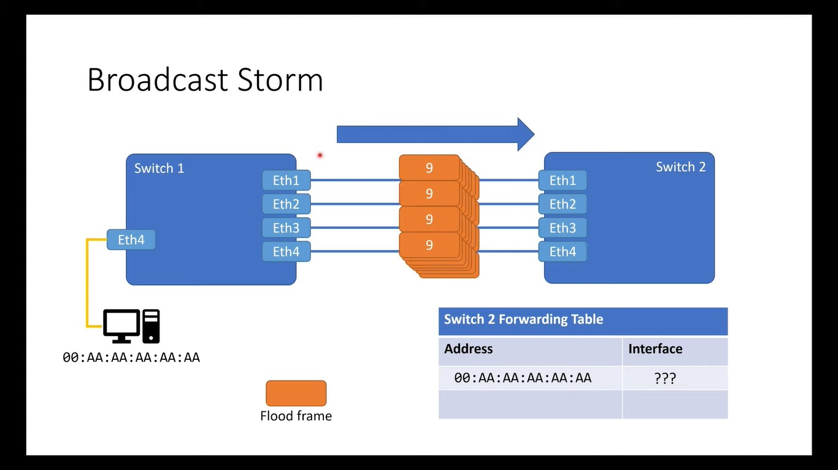

Slide 19
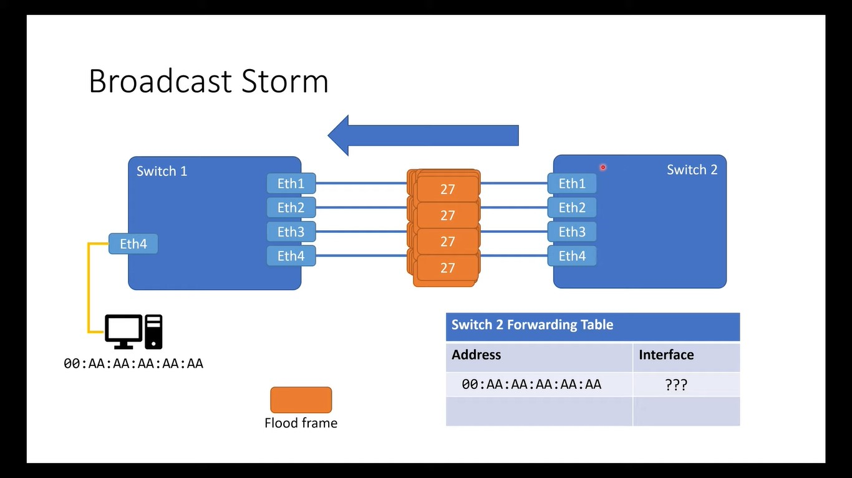

Slide 20
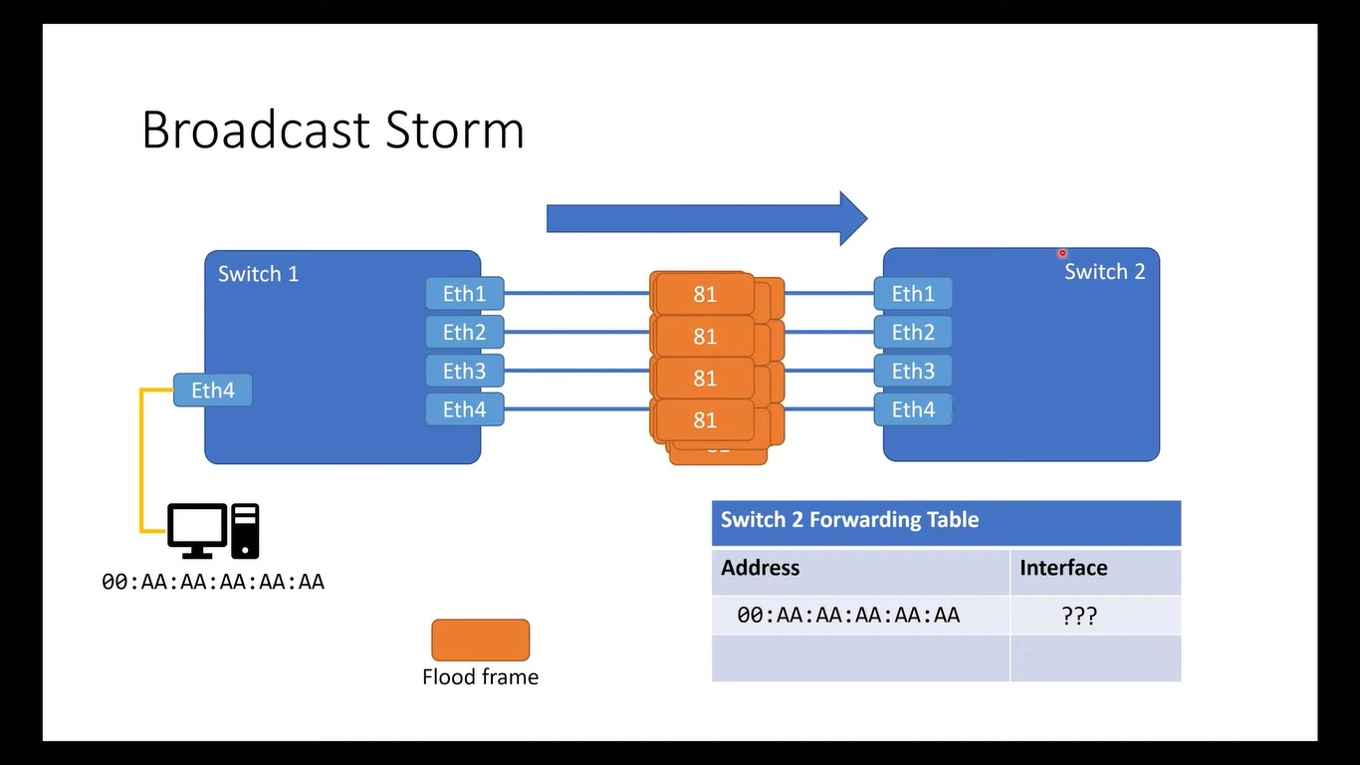

Slide 21


Slide 22
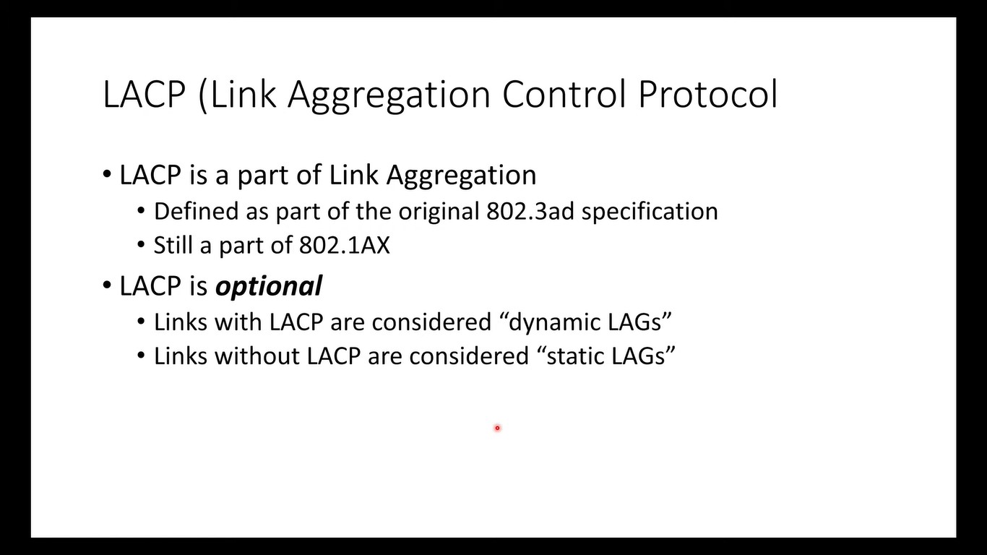

Slide 23
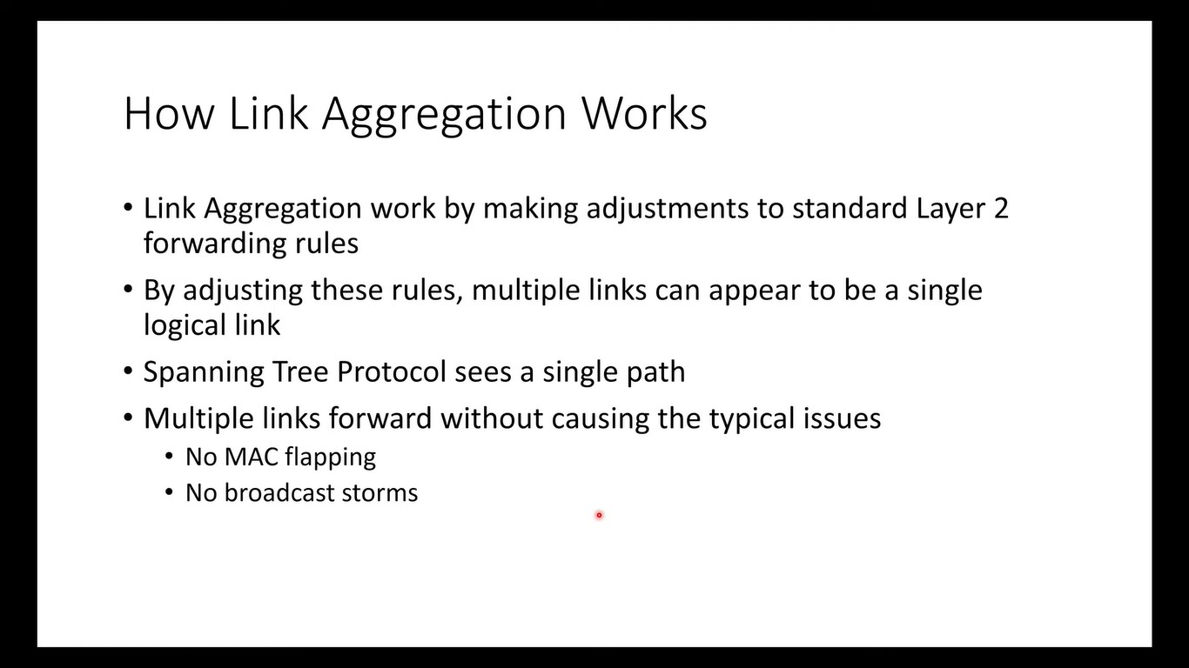

Slide 24
Link Aggregation Control Protocol (LACP)?
LACP lets devices to send Link Aggregation Control Protocol Data Units (LACPDUs) to each other to establish a link aggregation connection.
We still need to configure the LAG on each device, but LACP helps prevent one of the most common problems that can occur during the process of setting up link aggregation: misconfigured LAG settings.
If the devices detect that they cannot establish a link aggregation connection, they do not try to establish it, and the link shows as “down” in the admin interface.
Another useful feature of LACP is that when one member link stops sending LACPDUs (if the cable is unplugged, for example), it is removed from the LAG. This helps to minimize packet loss.
Both devices must support LACP for you to set up a dynamic LAG between those devices. It is recommend to use LACP instead of a static LAG whenever both devices support LACP.

Slide 25
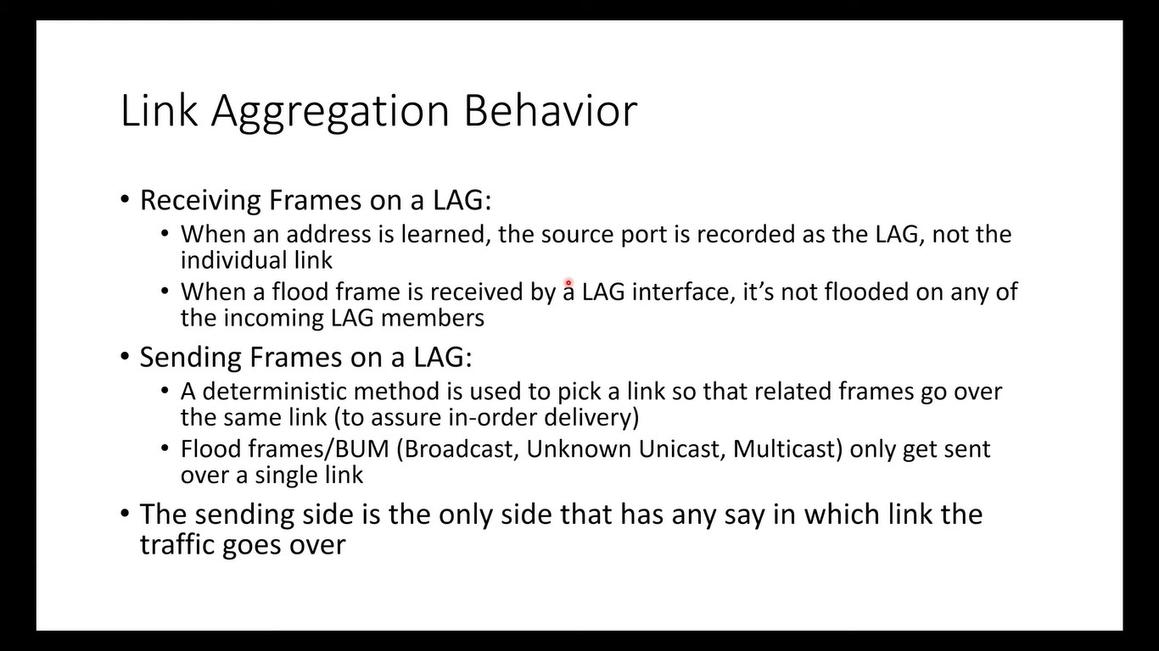

Slide 26
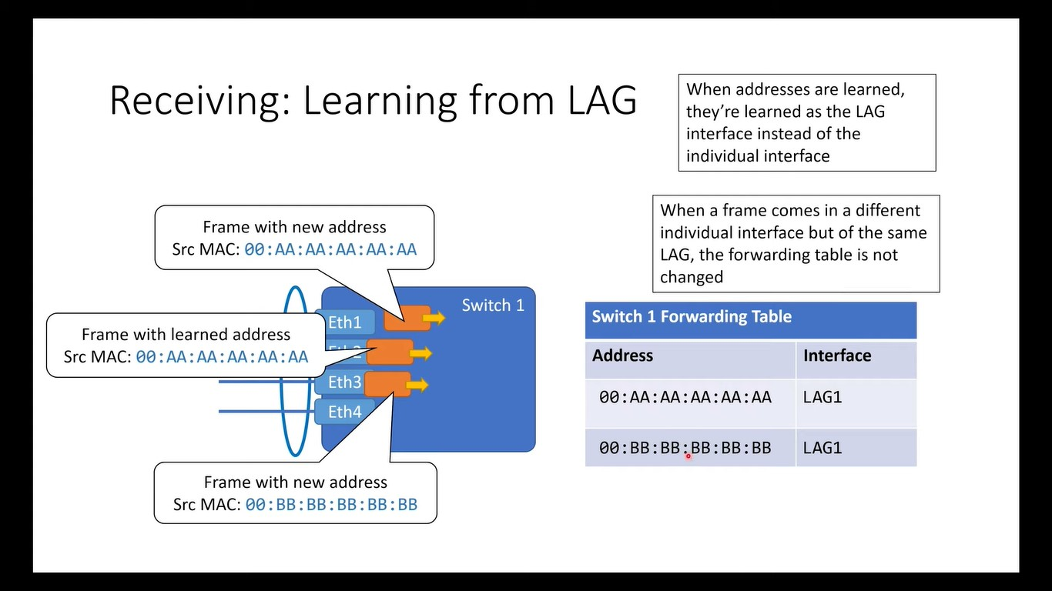

Slide 27
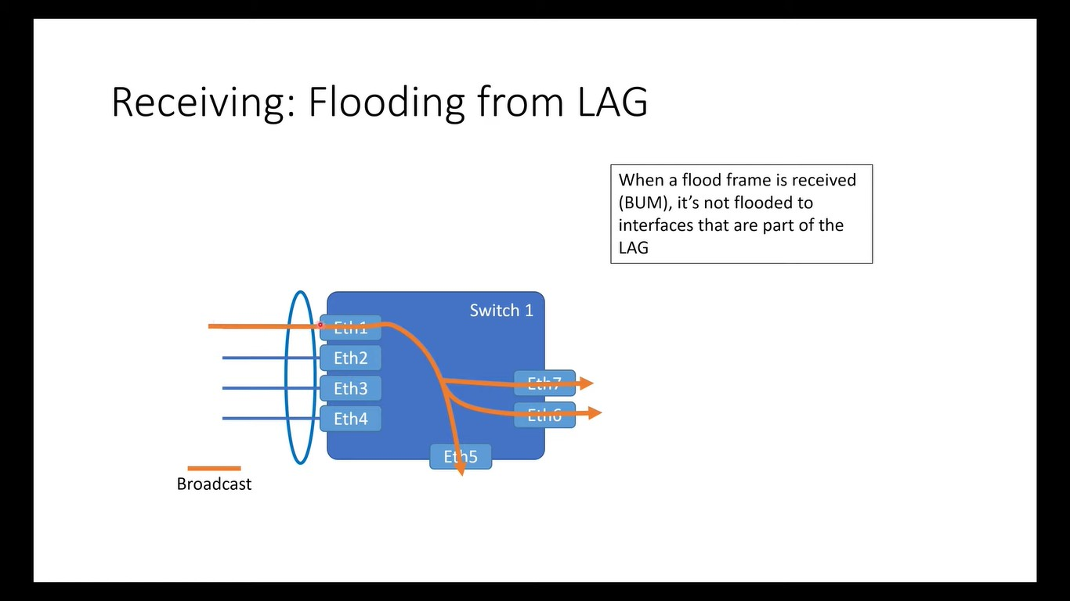

Slide 28
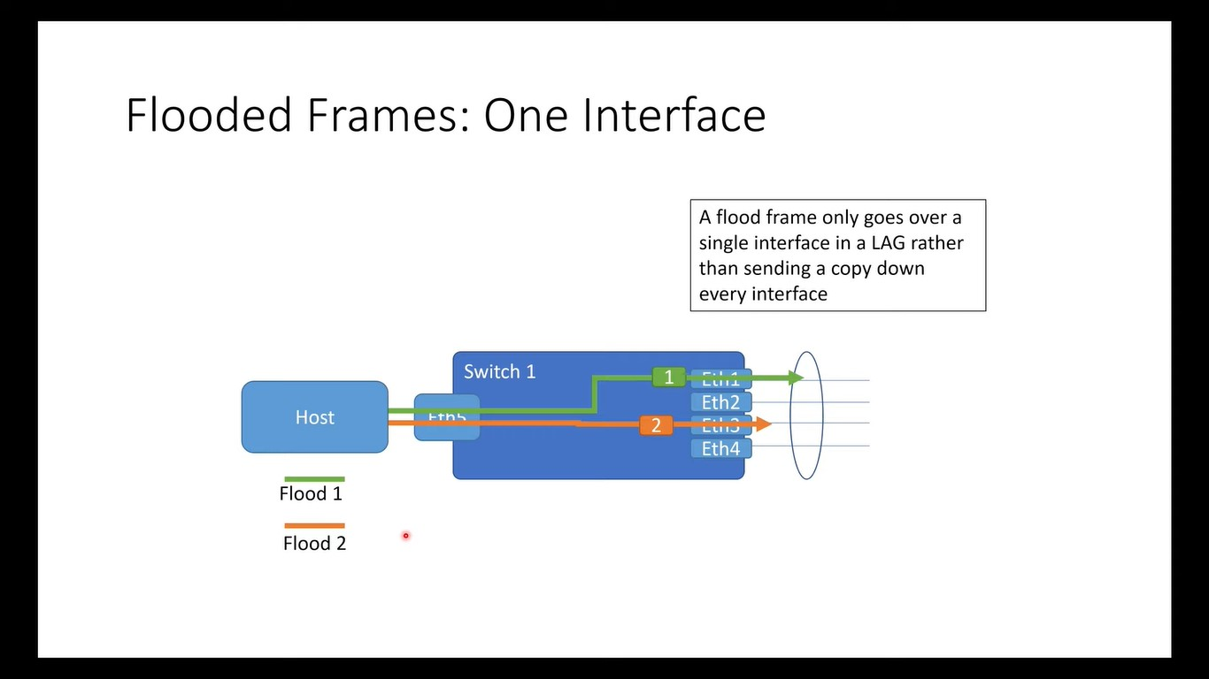

Slide 29
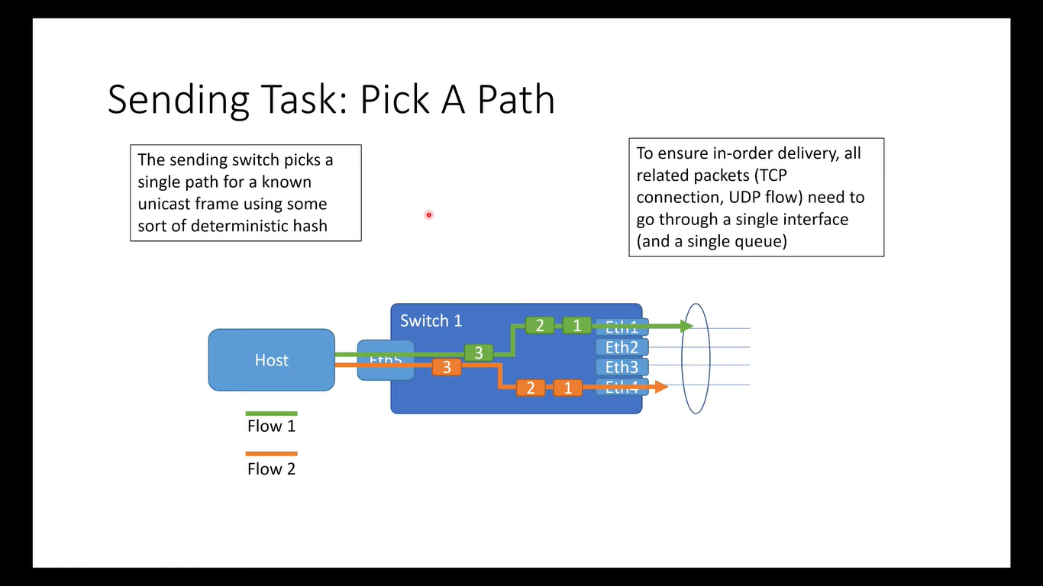

Slide 30
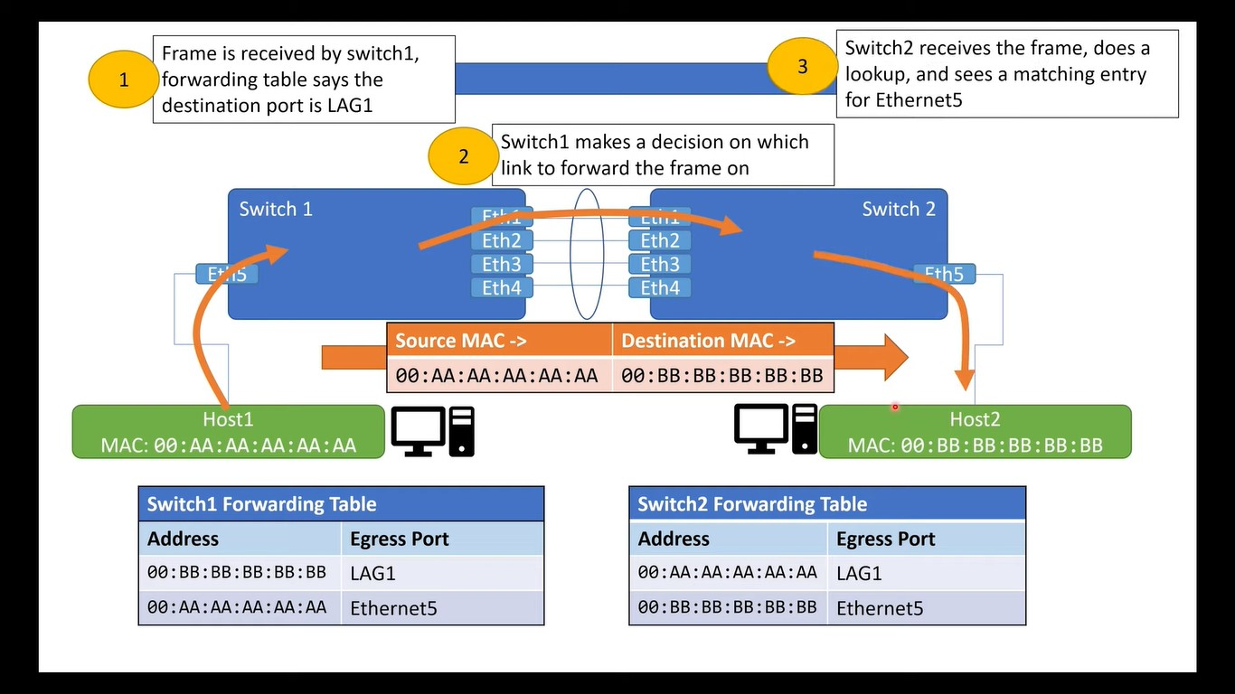

Slide 31
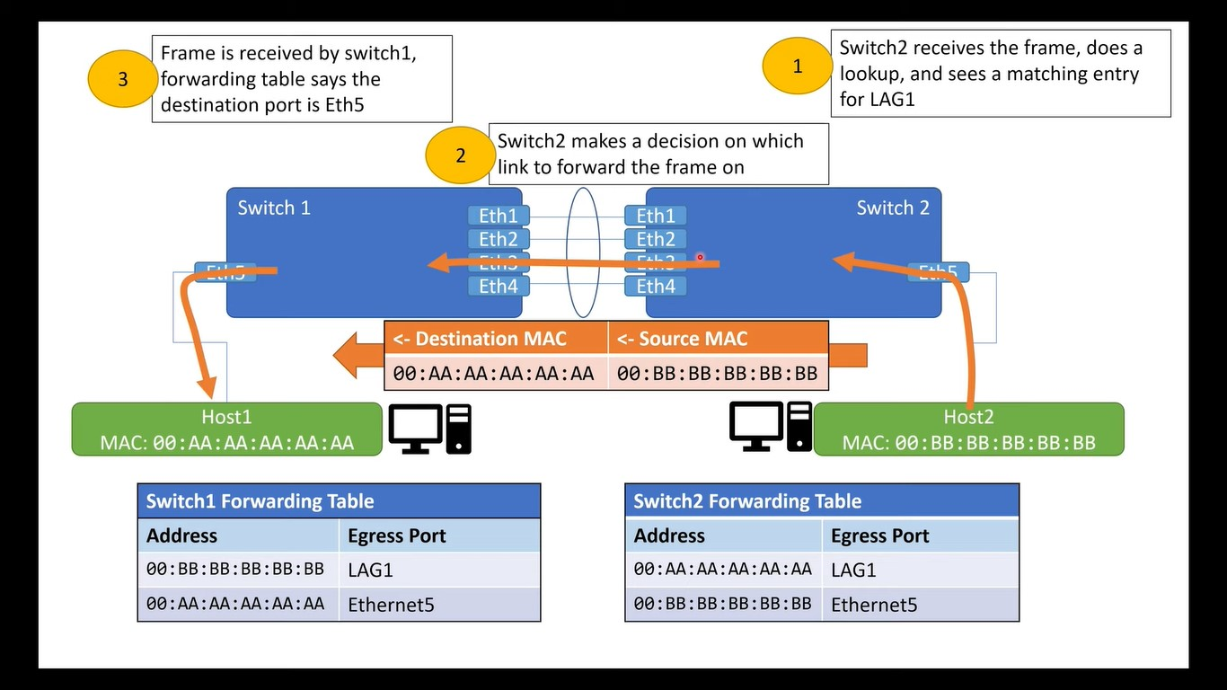

Slide 32
To set up Link Aggregation between two devices:
Make sure that both devices support link aggregation.
Configure the LAG on each of the two devices.
Make sure that the LAG that you create on each device has the same settings for port speed, duplex mode, flow control, and MTU size (on some devices, this setting might be called jumbo frames).
Make sure that all ports that are members of a LAG have the same virtual local area network (VLAN) memberships.
If you want to add a LAG to a VLAN, set up the LAG first and then add the LAG to the VLAN; do not add individual ports.
Note which ports on each device you add to the LAG, and make sure that you connect the correct ones.
The LAG issues an alert and rejects the configuration if port members have different settings for port speed, duplex mode, or MTU size, or if you accidentally connect ports that are not members of the LAG.
Use Ethernet or fiber cable to connect the ports that you added to the LAG on each device.
Verify that the port LED for each connected port on each switch is blinking green.
Verify in the admin interface for each device that the link is UP.

Slide 33
Configuration:
Topology:
lagaf-optics-p1c3-01 ge-0/0/27 <---> lagaf-optics-p1c3-02 ge-0/0/27
lagaf-optics-p1c3-01 ge-0/0/28 <---> lagaf-optics-p1c3-02 ge-0/0/28
Configure interfaces for ae0/LAG:
R0: lagaf-optics-p1c3-01:
set chassis aggregated-devices ethernet device-count 5
set interfaces ge-0/0/27 ether-options 802.3ad ae0
set interfaces ge-0/0/28 ether-options 802.3ad ae0
set interfaces ae0 unit 0
R1: lagaf-optics-p1c3-02:
set chassis aggregated-devices ethernet device-count 5
set interfaces ge-0/0/27 ether-options 802.3ad ae0
set interfaces ge-0/0/28 ether-options 802.3ad ae0
set interfaces ae0 unit 0

Slide 34
Configure LACP for ae0 and configure periodic transmission of LACP packets:
lagaf-optics-p1c3-01:
set interfaces ae0 aggregated-ether-options lacp active periodic fast
commit
lagaf-optics-p1c3-02:
set interfaces ae0 aggregated-ether-options lacp active periodic fast
commit

Slide 35
Verify Lag Creation
regress@lagaf-optics-p1c3-01> show interfaces terse ae0
Interface Admin Link Proto Local Remote
ae0 up up
ae0.0 up up
{master:0}
regress@lagaf-optics-p1c3-01>
regress@lagaf-optics-p1c3-02> show interfaces terse ae0
Interface Admin Link Proto Local Remote
ae0 up up
ae0.0 up up
{master:0}
regress@lagaf-optics-p1c3-02>

Slide 36
Verify LACP Statistics
regress@lagaf-optics-p1c3-01> show lacp statistics interfaces ae0
Aggregated interface: ae0
LACP Statistics: LACP Rx LACP Tx Unknown Rx Illegal Rx
ge-0/0/27 29 30 0 0
ge-0/0/28 29 30 0 0
{master:0}
regress@lagaf-optics-p1c3-01>
The LACP received counter that increments for each normal hello
The number of LACP transmit packet errors logged
The number of unrecognized packet errors logged
The number of invalid packets received

Slide 37
Verify LACP Statistics
regress@lagaf-optics-p1c3-01> show lacp interfaces ae0
Aggregated interface: ae0
LACP state: Role Exp Def Dist Col Syn Aggr Timeout Activity
ge-0/0/27 Actor No No Yes Yes Yes Yes Fast Active
ge-0/0/27 Partner No No Yes Yes Yes Yes Fast Active
ge-0/0/28 Actor No No Yes Yes Yes Yes Fast Active
ge-0/0/28 Partner No No Yes Yes Yes Yes Fast Active
LACP protocol: Receive State Transmit State Mux State
ge-0/0/27 Current Fast periodic Collecting distributing
ge-0/0/28 Current Fast periodic Collecting distributing
{master:0}
regress@lagaf-optics-p1c3-01>

Slide 38
Verify LACP Statistics
The LACP state—Indicates whether the link in the bundle is an actor (local or near-end of the link) or a partner (remote or far-end of the link).
The LACP mode—Indicates whether both ends of the aggregated Ethernet interface are enabled (active or passive)—at least one end of the bundle must be active.
The periodic link aggregation control PDU transmit rate.
The LACP protocol state—Indicates the link is up ifit is collecting and distributing packets.

Slide 39
Thank You

